Slide 1



Hardware and Software Fundamentals of Intelligent Computing Systems

Slide 2
Lecture 15: Operator Fusion

Slide 3
Outline
Operator Fusion
Example: Fused Softmax

Slide 4
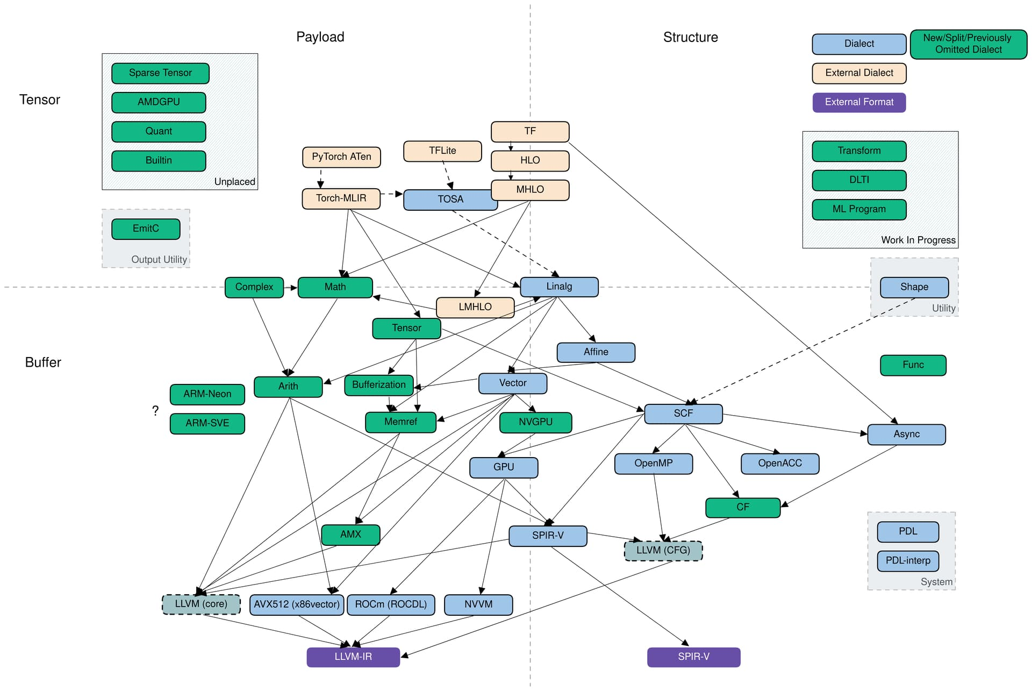
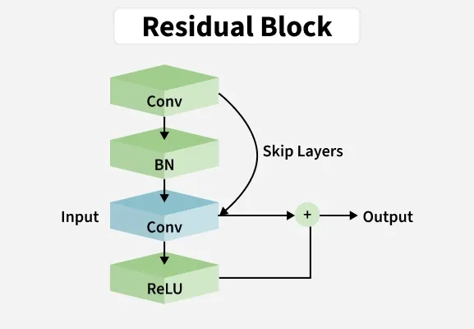
Lifecycle of Operators
Frame layer:
Data graph normalization: Break down high-level composite operators in deep neural networks (e.g., TransformerBlock) into fine-grained primitives (MatMul, Softmax, LayerNorm), and establish standardized IR frameworks (e.g., MLIR, XLA HLO).
Calculate the tensor lifecycle through data stream analysis and determine the parallel strategy
Convert the optimized compute graph Lowering into device-specific code and insert necessary synchronization primitives

Slide 5
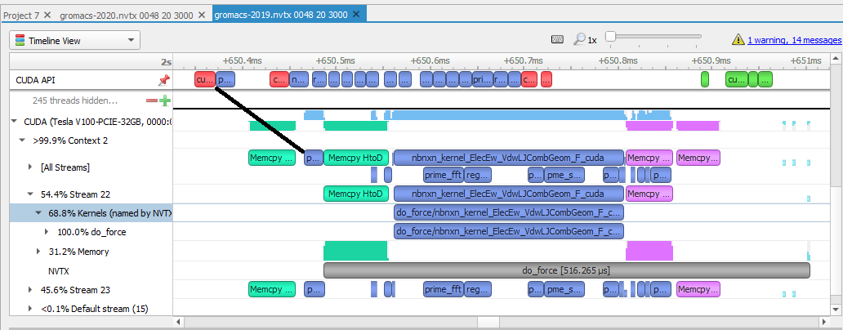
Lifecycle of Operators
Runtime layer:
Prepare parameters for each operator (device pointer, shared memory size, Stream ID, and other context)
Initiate Kernel Launch
hardware layer ：
GPU reads data from Global Memory---> compute unit processes---> writes back to Global Memory

Slide 6
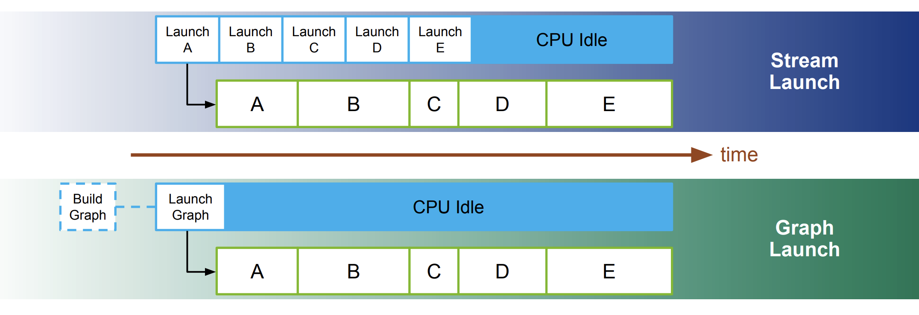
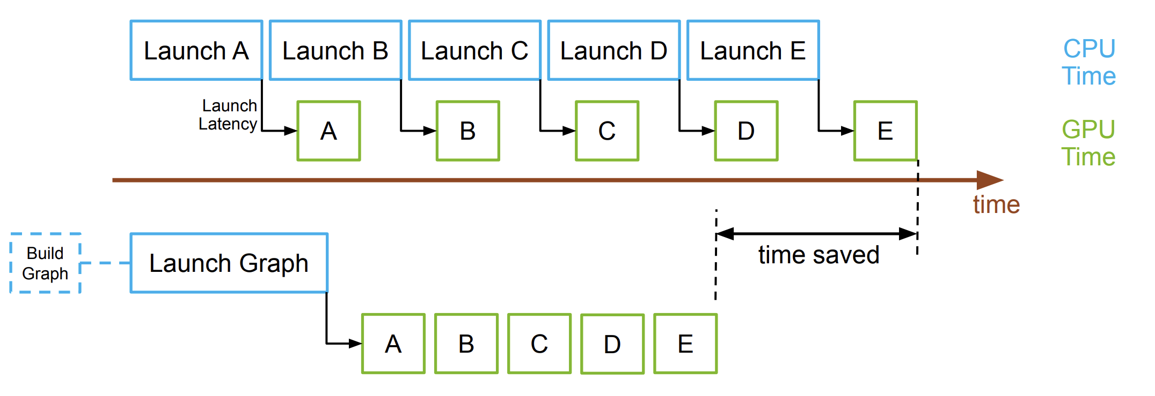
Kernel Launch Optimization: CUDA Graph
Record a series of GPU operations (Kernels, Memcpys) as a static topology diagram
Capture the execution sequence, parameters, video memory addresses, and scheduling paths of all kernels during the phase.
During the replay phase, the CPU only needs to issue a single ultra-lightweight instruction to trigger the entire graphs automatic transfer on the GPU.
minimal GPU kernel
general-purpose GPU kernel

Slide 7
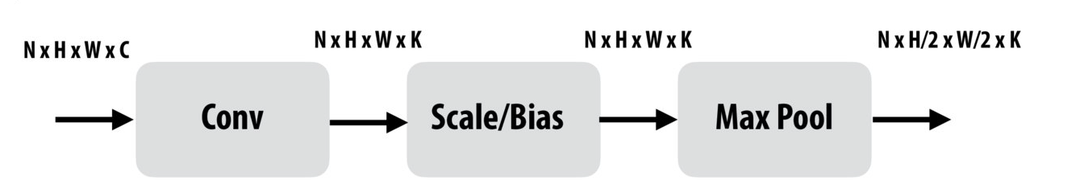
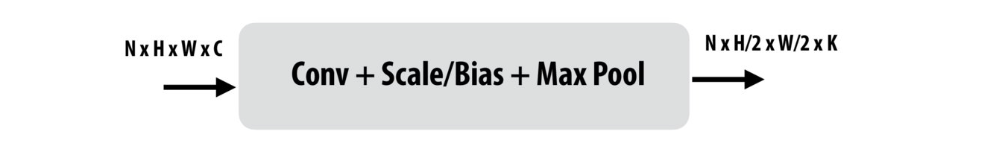
Data transfer between operators
Default mode: Conv results must be written back to global video memory, then Scale reads them out
Operator fusion: Element-wise operations can seamlessly integrate with other operators, significantly reducing both memory access and kernel startup overhead.

Slide 8
Operator Fusion
Definition: A technique that merges multiple independent operators (or kernels) in a computational graph into a single operator for execution.
Typical scenarios in deep learning:
Vertical Fusion: Conv + Bias + ReLU
Horizontal Fusion: Merge multiple GEMMs with the same input but different parameters
Reduction Fusion: Mean + Var + Scale in LayerNorm

Slide 9
Advantages of Operator Fusion
Reduce memory bandwidth usage: Eliminate read and write operations on global memory for intermediate results. Data remains in registers or shared memory.
Reduce Kernel Launch overhead: Minimize the number of handshakes between CPU and GPU
Enhance cache utilization: Data is continuously accessed in SRAM for higher efficiency
Increase computational density: Boost the instruction stream per task to better mask memory latency

Slide 10
Problems of Operator Fusion
Core contradiction-Register pressure
The total number of registers in a GPU SM is fixed (for example, A100 has 256KB per SM).
Single-threading requires more intermediate states → Single-threading registers ↑ → Each thread block occupies registers ↑ → Concurrent thread blocks decrease → Reduced active Warp count in SM (Occupancy decreases)
Instruction cache pressure:
The merged kernel may exceed the hardware instruction cache limit.
Finding the sweet spot between saving memory bandwidth and maintaining sufficient computational parallelism

Slide 11
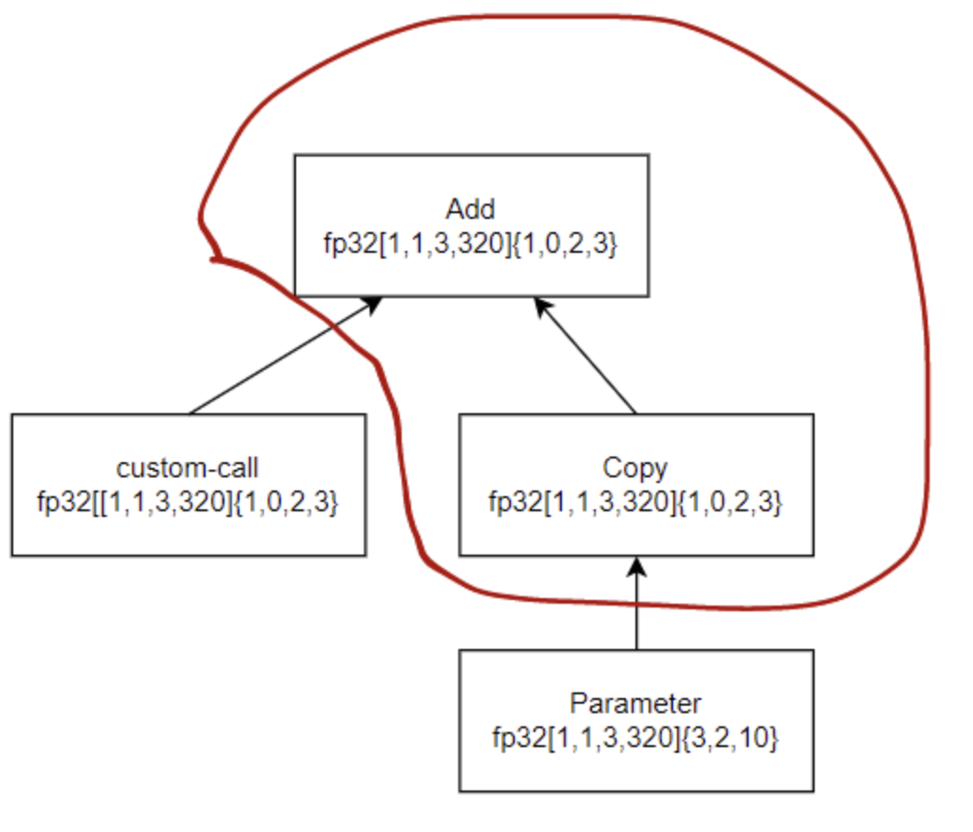
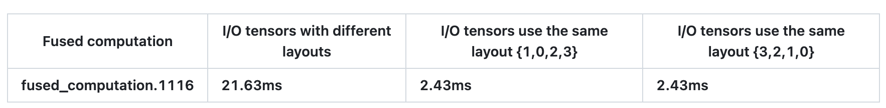
A Negative Example: The Greedy Merging of XLA
Scene description
The inputs forced layout is {3,2,1,0}, and the operator (Custom-call) has a forced layout of {1,0,2,3}.
When computing Add, XLA detects that the two inputs have different layouts. To align them, it must insert a Copy operation.
To reduce kernel boot overhead, XLA forcibly merges Add and Copy operations. However, inconsistent I/O layouts disrupt memory merge access, causing memory access to become random and erratic, resulting in a 9-fold performance degradation.
https://github.com/openxla/xla/discussions/766

Slide 12
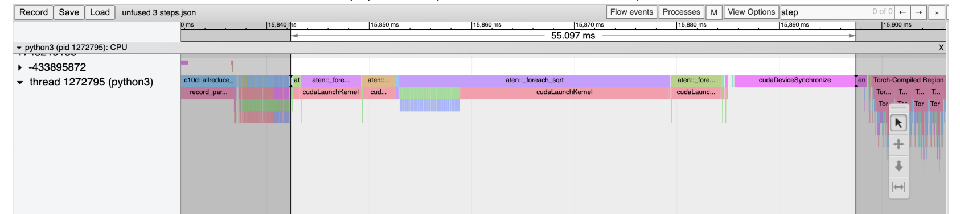
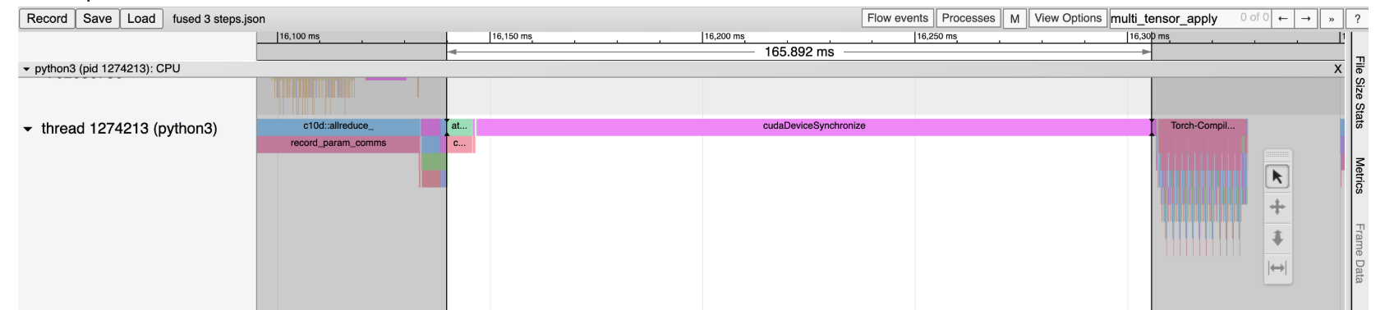
A negative example: Fused Adam
Pytorchs auto-enabled Fused AdamW algorithm experiences a dramatic performance drop on A40 GPUs. Potential causes include:
The number of registers used in Fuse mode is approximately double that of standard mode.
Fused AdamW is triggered per-tensor, causing excessive Kernel launches
https://github.com/pytorch/pytorch/issues/121857

Slide 13
Outline
operator fusion
Example: Fused Softmax

Slide 14
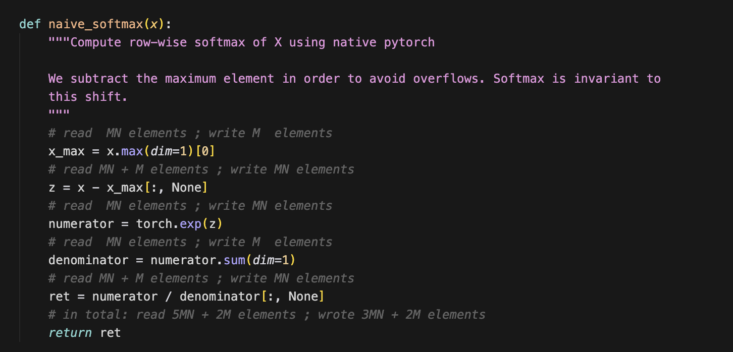
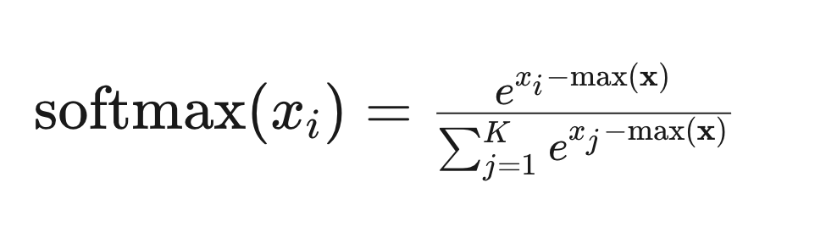
Example: Softmax
Formula
Performance bottleneck: Total reads 5MN+2M elements, writes 3MN+2M elements. Frequent global memory reads/writes cause significant bandwidth waste.

Slide 15
Example: Softmax
Basic Idea of Operator Fusion
Load: All threads collaborate in parallel to read data from Global Memory and write it to Shared Memory
Sync & Reduce: Perform multiple iterations within Shared Memory, which is fully executed at high speed on-chip without consuming video memory bandwidth.
CUDA: Synchronize with __syncthreads() at each step
Triton: Automatic
Write: Only the final result is written back to Global Memory.

Slide 16
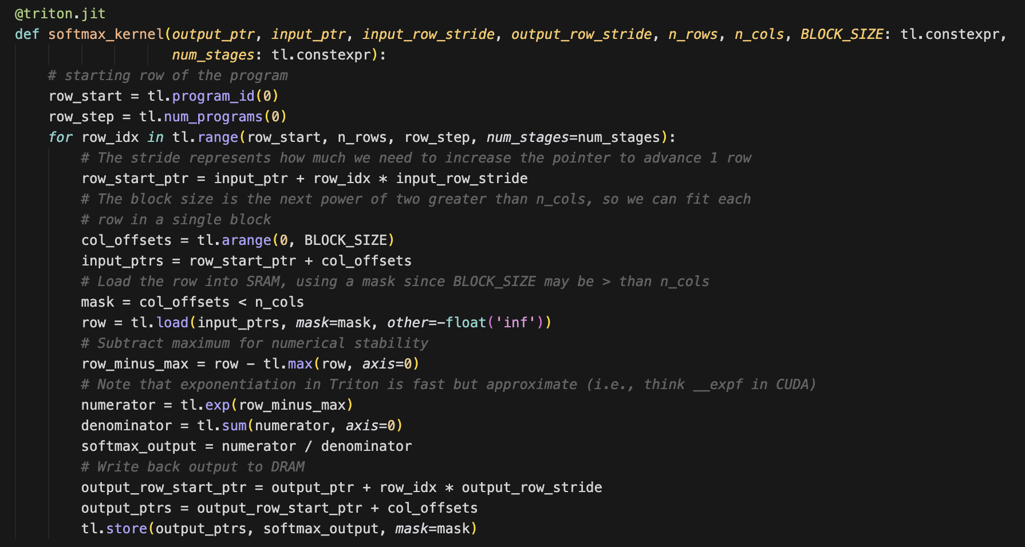
Softmax_kernel
SRAM Residency: The entire row of data remains on-chip after loading until the computation is completed.
memory pointer calculation
loading
Data writeback

Slide 17
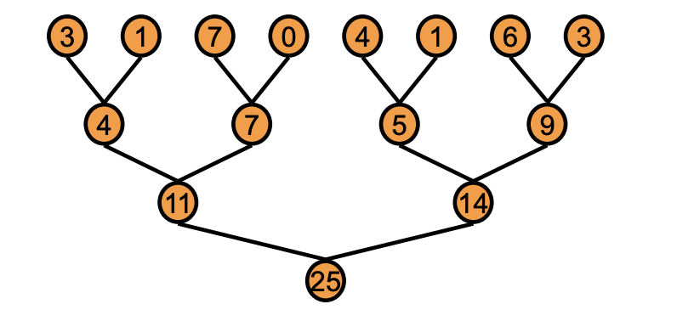
Softmax_kernel
Operator Fusion: Merge Max, Sub, Exp, and Sum into a Kernel
Internal Automatic Realization of Parallel Tree Structure
operator fusion

Slide 18
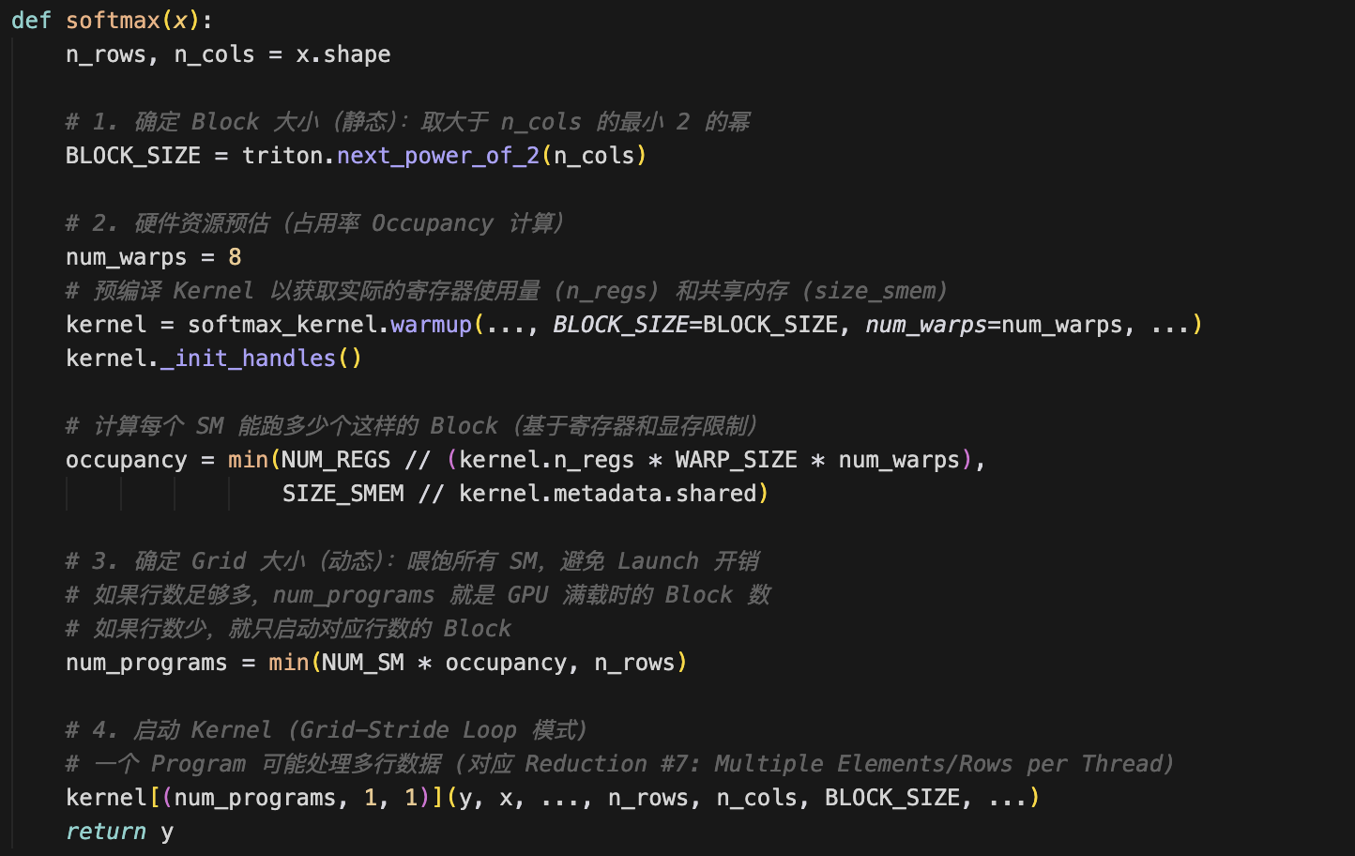
SoftMax Host
static kernel specialization
Align input dimensions to the 2nd power
Ensure the kernel parameter BLOCK_SIZE is a compile-time constant to allow the compiler to perform full loop unrolling and eliminate runtime branch overhead.

Slide 19
SoftMax Host
hardware-aware utilization
Detect the actual consumption of registers and SRAM by the warmup kernel
Maximize the number of active warps per SM

Slide 20
SoftMax Host
Persistent Grid Startup
Decouple grid size from data volume
Each Block processes multiple rows of data serially through the Grid-Stride Loop.

Slide 21
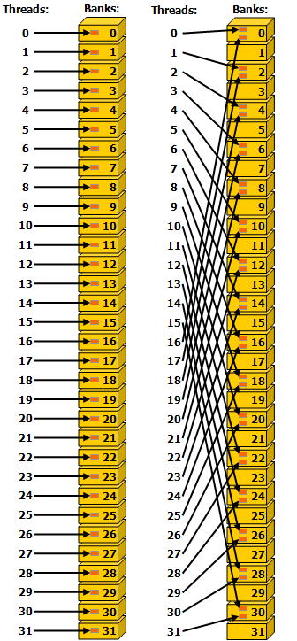
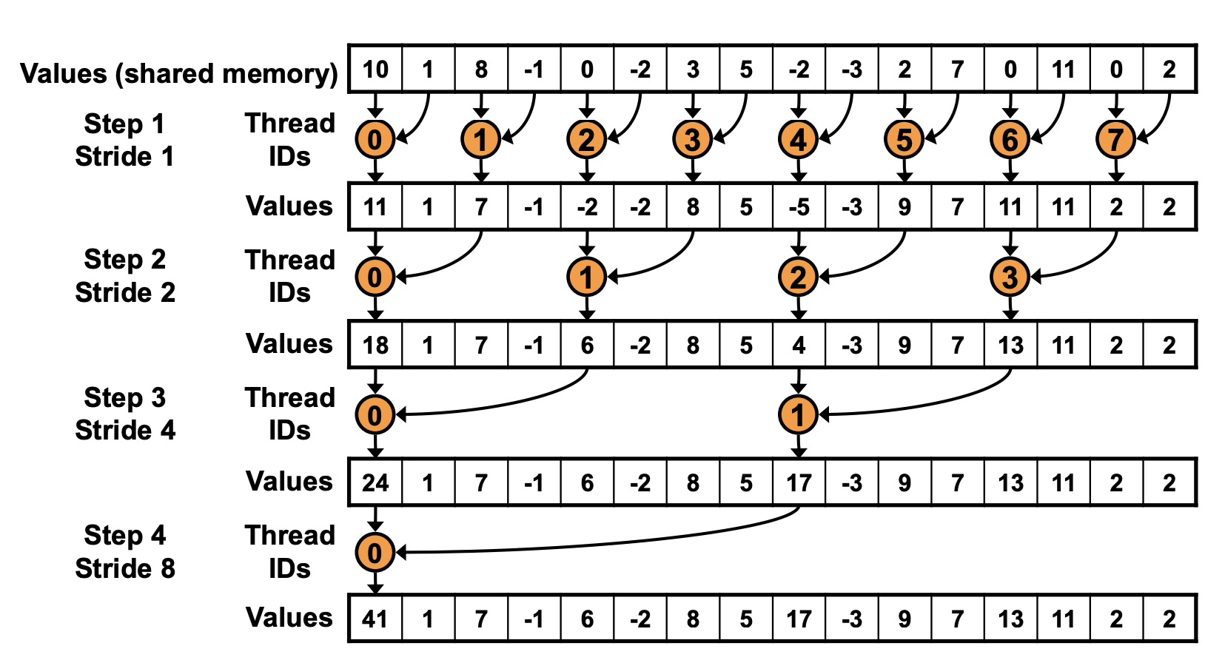
Optimization Behind: Continuous addressing
Interleaved addressing may cause bank conflicts.

Slide 22
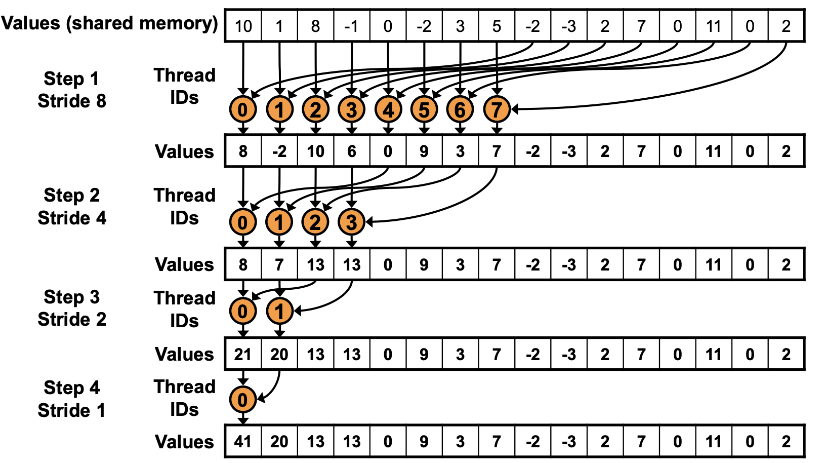

Optimization Behind: Continuous addressing
Continuous addressing (where adjacent threads access contiguous data) maximizes memory bandwidth.
Compared to CUDA, Triton makes it much harder to write erroneous code by explicitly calling tl.arange().
Continuous index was generated automatically

Slide 23
Optimization Behind: Algorithm Cascading
A single thread processes multiple data sets, increasing the workload per thread, hiding latency, and reducing Block startup overhead.
If BLOCK_SIZE is significantly larger than the number of physical threads, the Triton compiler automatically executes a loop within each physical thread to process BLOCK_SIZE divided by the number of threads.
theoretical analysis
Simple solution: Allocate O(N) threads, with time complexity O(log N) and total cost O(N log N).
Brent theorem optimization: Using O(N/log N) threads, each thread processes O(log N) elements serially, then all threads collaborate to perform O(log N) parallel reduction steps
Total cost = O(N/log N) × O(log N) = O(N) → Cost-efficient

Slide 24
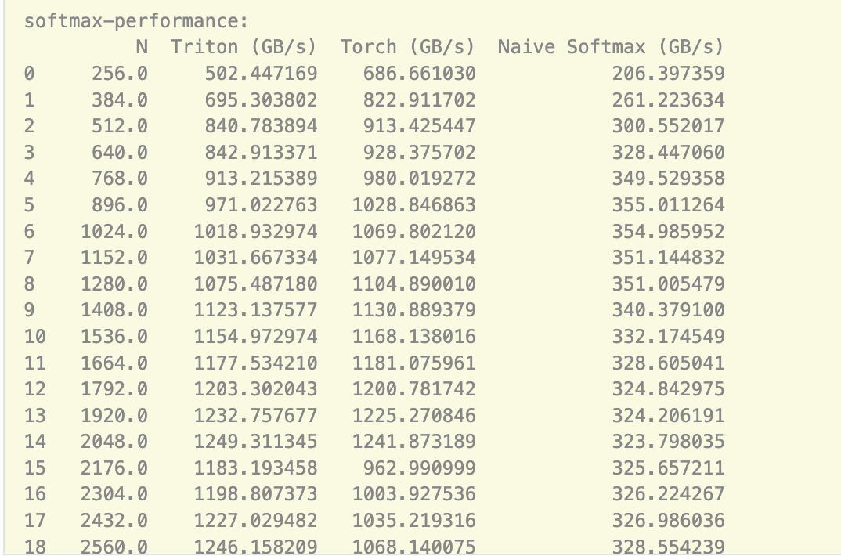
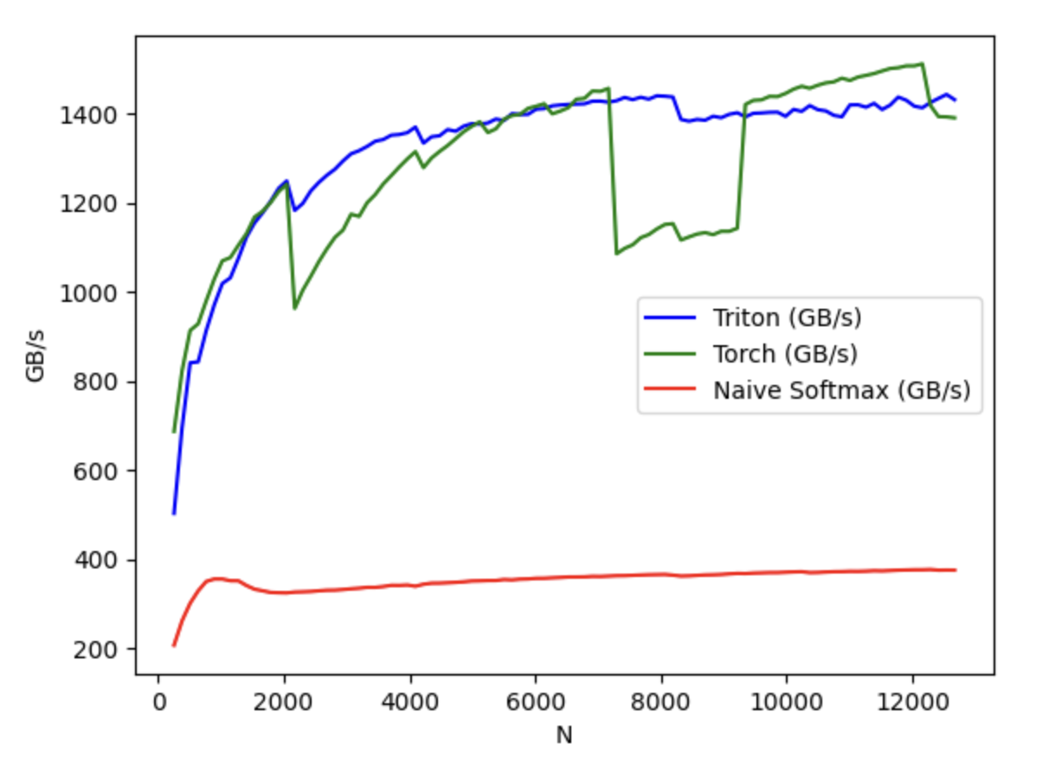
Performance Comparison

Slide 25
References
https://docs.flagos.io
https://developer.download.nvidia.com/assets/cuda/files/reduction.pdf
https://www.bu.edu/pasi/files/2011/07/Lecture31.pdf
http://fleetwood.dev/posts/layernorm-as-fast-as-possible
https://gfxcourses.stanford.edu/cs149/fall25
https://triton-lang.org/main/getting-started/tutorials/

Slide 26

The Solution: FlagOS, a Unified AI Software Stack

Slide 27








https://space.bilibili.com/3546791834290849
https://github.com/flagos-ai
https://www.zhihu.com/people/95-22-20-18/posts
https://flagos.io/Home

Slide 28

Thanks for your time！

